Slide 1



Encryption in Amazon S3: Securing Your Cloud Data
When you store data in Amazon S3 (Simple Storage Service), keeping it secure is essential. This is where encryption comes in. Encryption ensures that your data is converted into a secure format that can only be read or accessed by someone who has the decryption key.
Here's a simple explanation of how encryption works in S3 and why it's important:
by Ram N Java

Slide 2


What is Encryption?
Data Protection
Encryption is like locking your data in a safe. Even if someone manages to access your S3 bucket without permission, they won't be able to understand the data unless they have the right key to unlock it.

Slide 3


Types of Encryption in Amazon S3
Server-Side Encryption (SSE)
Amazon S3 encrypts your data after you upload it and decrypts it when you download it.
You don't have to manage the encryption yourself. There are three types of SSE:
1. SSE-S3 (Default)
S3 manages the encryption keys for you. Every object is encrypted with a unique key,
and those keys are encrypted using a master key.
2. SSE-KMS (Key Management Service)
You use AWS Key Management Service (KMS) to manage the encryption keys.
This gives you more control over who can access your keys and provides auditing features.
3. SSE-C (Customer-Provided Keys)
You provide your own encryption keys. AWS uses your keys to encrypt and decrypt your data
but doesn't store them.
Client-Side Encryption
In this case, you encrypt the data yourself before uploading it to S3 and decrypt it after downloading.
This provides maximum control since only you have the keys.

Slide 4


Why Use Encryption?
1
Data Security
Protect sensitive information, even if someone gains unauthorized access to your storage.
2
Compliance
Meet regulatory requirements for data protection, such as GDPR, HIPAA, or PCI-DSS.
3
Peace of Mind
Knowing your data is protected in the cloud reduces risks.

Slide 5


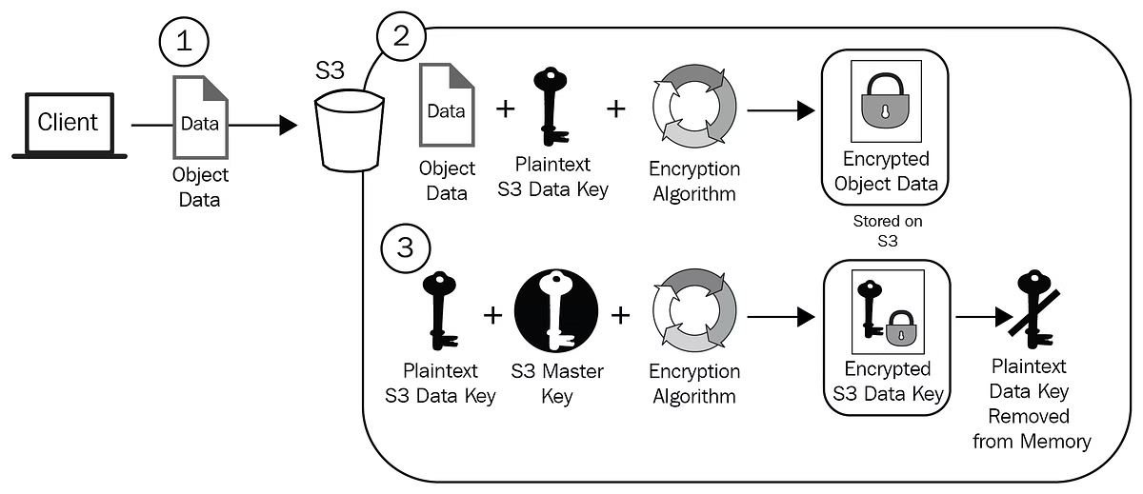


How Does S3 Encryption Work?
Upload Files
When you upload files to S3, you can choose to enable encryption.
Automatic Encryption
If you select SSE-S3 or SSE-KMS, Amazon S3 automatically encrypts the data for you.
Access and Download
Whenever you access or download your files, Amazon S3 decrypts them so you can read and use them as usual.

Slide 6
How to Enable S3 Encryption
S3 Management Console
AWS CLI
Bucket Policies
When creating a new bucket or uploading files, you can enable encryption under the "Properties" or "Object details" sections.
You can enable encryption when uploading files with commands like:
You can set a bucket policy that requires all uploaded data to be encrypted.
aws s3 cp yourfile.txt s3://your-bucket-name/ --sse AES256

